Slide 1

HEALTHCARE ANALYTICS
ON HEART DISEASE DATA
ABHISHEK JOSEPH

Slide 2
02
PROJECT DETAILS
.
Project Title | Healthcare Analytics on Heart Disease Data
Technologies | Business Intelligence | Data Analysis
Domain | Healthcare
Project Difficulty Level | Intermediate

Slide 3
03
Table of contents
1.
Problem Statement
4.
Conclusions
2.
About the dataset
5.
3.
Insights

Slide 4

PROBLEM STATEMENT
04
20-02-2022
Health is real wealth in the pandemic time we all realized the brute effects of covid-19 on all irrespective of any status. You are required to analyze this health and medical data for better future preparation.
A dataset is formed taking into consideration information of some individuals. Find key metrics and factors and show the meaningful relationships between attributes of the dataset

Slide 5

About DATA SET
05
The fourteen features in Dataset we refer to are:
Age: Age of different individuals in years
Sex: Gender of the individuals [1=Male , 0=Female]
Cp: Describes the Chest Pain experienced [0:aymptomatic , 1: Atypical Angina , 2: Non-Anginal Pain , 3:Typical Angina]
Trestbps: Describes the Resting Blood Pressure in mm/hg
Chol: Describes the Serum Cholesterol Level in mg/dl
Fps: Describes the Fasting Blood Sugar > 120 mg/dl [0 = no, 1 = yes]
Restecg: Describes the Resting ECG
[0: showing probable or definite left ventricular hypertrophy by Estes’ criteria, 1: normal, 2: having ST-T wave abnormality]

Slide 6
About DATA SET
05
Thalach: Describes the maximum heart rate achieved
Exang: Refers to Exercise Induced Angina [1 = yes, 0 = no]
Oldpeak: Refers to ST depression induced by exercise relative to rest
Slope: Describes the slope of the peak exercise ST segment [0: downsloping; 1: flat; 2: upsloping]
Ca: [number of major vessels (0–3)
Thal: A blood disorder called thalassemia [1 = normal, 2 = fixed defect, 3 = reversible defect]
Target: Heart Disease [0 = disease, 1 = no disease]

Slide 7

08
INSIGHTS

Slide 8
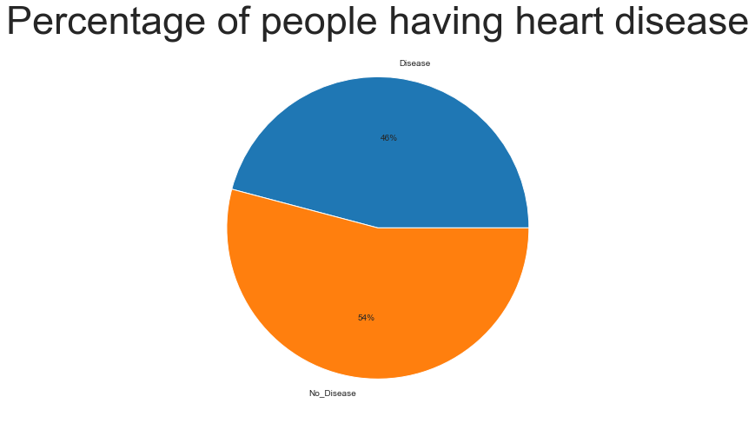
06
POPULATION
HEART DISEASE
46%
54%
NO DISEASE

Slide 9
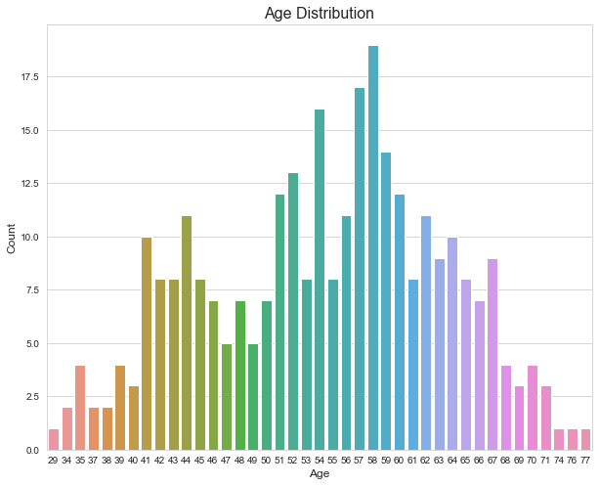
06
DISEASE BY AGE DISTRIBUTION

Slide 10
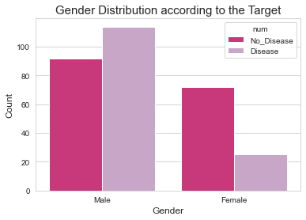
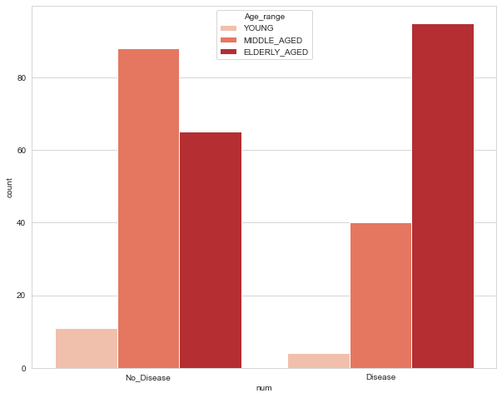
06
Count Plot of Heart Disease Based On Age Category
Count Plot Creation of Gender Based Age Category
We can infer that among Male heart disease patients are higher than Female heart disease patients i.e. Males are more prone to heart diseases
Middle Aged people are most affected by Heart Disease

Slide 11
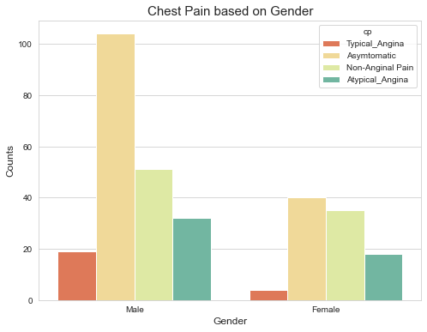
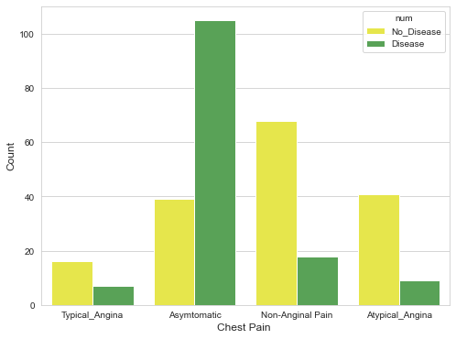
06
Chest Pain Distribution
Count Plot of Chest Pain Based On Gender
we can infer that majority of the heart disease patients are Asymptomatic
we can infer that highest numbers of patient are having asymptomatic condition followed by non- anginal chest pain among both males and females.

Slide 12
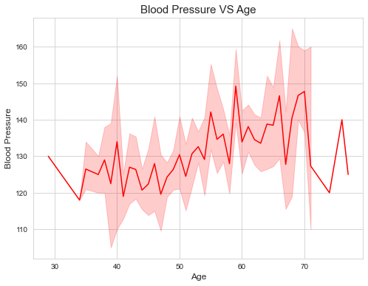
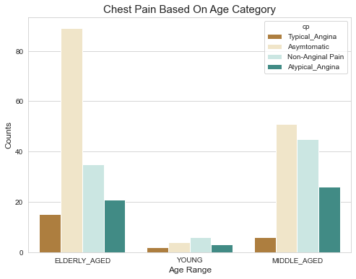
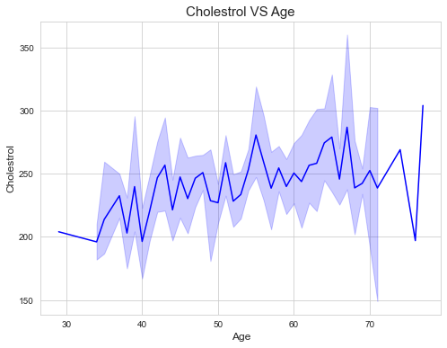
Cholesterol Level increases with the age and continues to increase till 65
we can infer that highest numbers of patient are having asymptomatic condition followed by non- anginal chest pain among both males and females.
Blood Pressure Levels increase between age group 50-60 and continues till 70

Slide 13

12
CONCLUSIONS

Slide 14

13
People suffering from heart disease constitutes 54% of the total population.
Most of the patients are in the age group 50-60.
Middle Aged people are most affected by Heart Disease
In our dataset Males are more in Middle Age Category and Females are more in Elderly Age category
Among Male heart disease patients are higher than Female heart disease patients i.e. Males are more prone to heart diseases

Slide 15
13
6. We can infer that majority of the heart disease patients are Asymptomatic.
7. highest numbers of patient are having asymptomatic condition followed by non- anginal chest pain among both males and females.
8. elder are more prone to asymptomatic heart disease condition while in middle aged group both asymptomatic and non- anginal chest pain condition is prevalent.
9. Blood Pressure Levels increase between age group 50-60 and continues till 70.

Slide 16
13
10. Females have little bit of higher cholesterol than Males.
11. Higher Cholesterol Levels results chances of Heart Disease.
12. Cholesterol Level increases with the age and continues to increase till 65.
13. Fasting blood sugar or fbs is a diabetes indicator with fbs >120 mg/d is considered diabetic (True class)
we observe that the number for class true, is lower compared to class false. However, there are higher number of heart disease patient without diabetes hence fbs might not be a strong feature differentiating between heart disease an non-disease patient.

Slide 17
14
Thanks!
Do you have any questions?
abhishekj6511@gmail.com
linkedin.com/in/abhishekrichardjoseph
https://github.com/abhishekRjoseph

